Slide 1
Group 9
DELIVARABLE 2
GROUP MEMBERS
SIFA NGARI –
FRANCES AYANGO – 136046
SANDRA WANJIRU – 146399
DENISE NDIRANGU – 145813
EDINAH KAMAU - 145491

Slide 2
QUESTIONS TO ANSWER
The borrowing rate across different times of the year .
The disbursement rate across the year.
The demographic trend of the fundraisers across different regions in relation to time of the year.

Slide 3
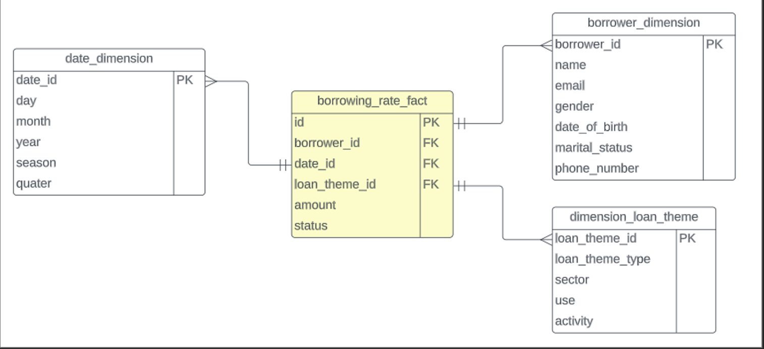
STAR DIAGRAMS
QUESTION 1 : Borrowing rate

Slide 4
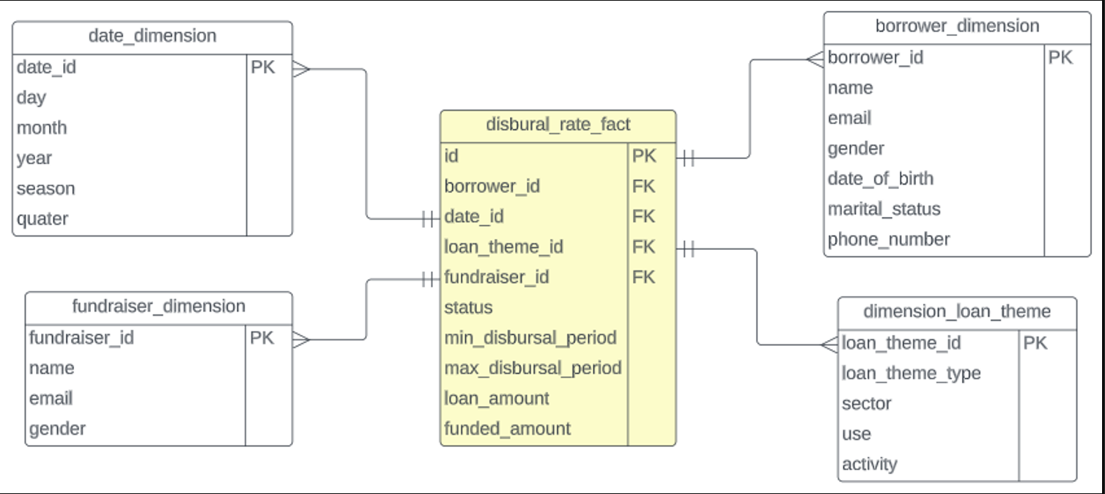
QUESTION 2 : Disbursement rate

Slide 5
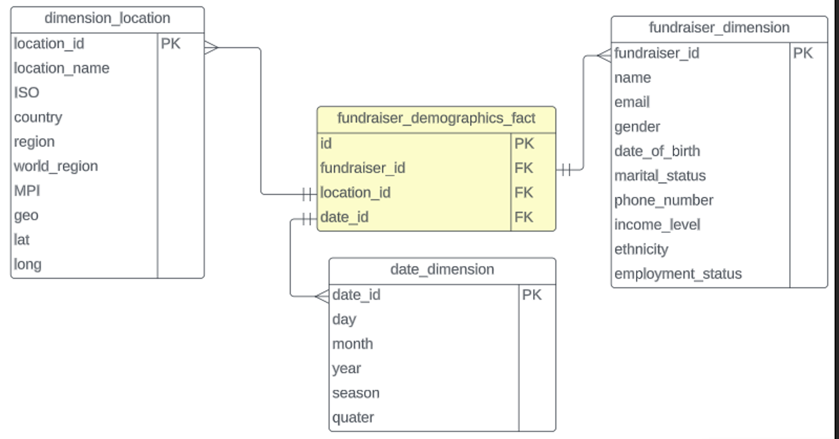
QUESTION 3 : Demographic trend of fundraisers

Slide 6
What is a data mart?
A data mart is a subset of a data warehouse focused on a particular line of business, department, or subject area.
Data marts make specific data available to a defined group of users, which allows those users to quickly access critical insights without wasting time searching through an entire data warehouse.

Slide 7
What TYPE OF DATA MART DID WE IMPLEMENT?
DEPENDENT DATA MART
A dependent data mart lets you combine all your business data into a single data warehouse, giving you the typical benefits of centralization.

Slide 8
What TYPE OF DATA MART DID WE IMPLEMENT?
DEPENDENT DATA MART
A dependent data mart lets you combine all your business data into a single data warehouse, giving you the typical benefits of centralization.

Slide 9
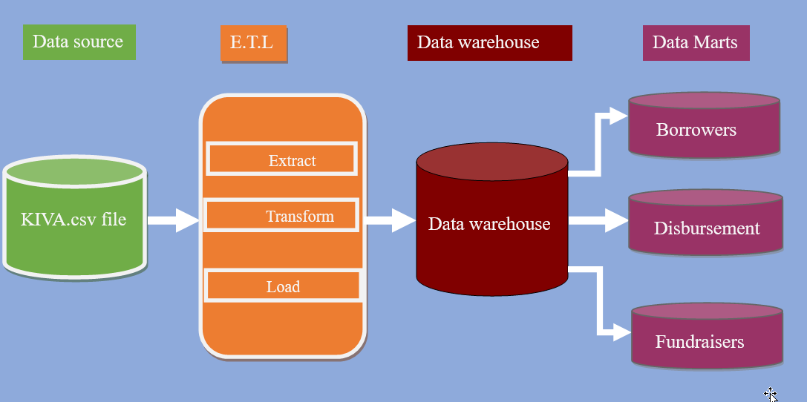
DEPENDENT DATA MART DIAGRAM

Slide 10
THE END! THANK YOU

